Slide 1



Cyclone Prediction
Developed by : Ankita Banerjee
AICTE Student ID: STU687797aee9bf21752668078
AICTE Internship ID: INTERNSHIP_17513641056863b20937d78

Slide 2

Learning Objectives
Understand and analyze cyclone-related datasets (wind speed, pressure, rainfall, sea surface temperature, etc.).
Perform data preprocessing, feature engineering, and visualization to extract meaningful patterns.
Apply machine learning techniques (Random Forest Classifier) to predict cyclone categories with accuracy.
Evaluate model performance using metrics (accuracy, confusion matrix, classification report).
Identify key environmental factors that influence cyclone intensity and impact.
Build an interactive framework that allows user input for cyclone condition prediction.
GOAL
Source :
www.freepik.com/

Slide 3
Tools and Technology used
Programming Language : Python (version 3.9.13)
Frameworks & Libraries:
Machine Learning: Scikit-learn (RandomForestClassifier, preprocessing, evaluation)
Data Handling: Pandas, NumPy
Visualization: Matplotlib, Seaborn
Model Evaluation: Scikit-learn metrics (accuracy, classification report, confusion matrix)
Environment: Jupyter Notebook (for development, experimentation, and visualization)
Dataset: Synthetic cyclone dataset (400 rows) containing features such as wind speed, pressure, rainfall, sea surface temperature, duration, affected population, and economic damage
Other Tools:
Git/GitHub (for version control and project management)
PowerPoint

Slide 4
Methodology
Problem Statement
Cyclones cause massive loss of life and property every year.
Early prediction of cyclone intensity and impact is essential for disaster preparedness and risk management.
Objective: Develop a machine learning model to predict cyclone categories based on environmental and meteorological factors.
Data Collection
Dataset preprocessed and structured for modeling.
A synthetic dataset of 400 records was generated, containing features such as:
Year
Month
Max Wind Speed
Minimum Pressure
Sea Surface Temperature
Rainfall
Humidity
Duration
Affected Population
Economic Damage
Category (target).
Data Preprocessing
Handled categorical features (e.g., Month, Category) using Label Encoding.
Checked for missing values and outliers.
Performed exploratory data analysis (EDA) using visualization tools (Seaborn, Matplotlib).
Correlation analysis to identify relationships between features.

Slide 5
Methodology
Model Selection
Chose Random Forest Classifier for classification because:
It handles high-dimensional data effectively.
It is robust against overfitting.
Provides feature importance to analyze key predictors.
Model Training
Split the dataset into training (70%) and testing (30%) sets.
Trained the Random Forest model on training data.
Testing & Validation
Evaluated the trained model using the test set.
Used metrics such as Accuracy, Confusion Matrix, and Classification Report.
Achieved reliable prediction of cyclone categories.

Slide 6
Problem Statement:
Cyclones are among the most devastating natural disasters, causing extensive loss of life, large-scale destruction of infrastructure, and significant economic damage. The unpredictability of their intensity and impact makes it difficult for governments, disaster management authorities, and local communities to prepare adequately. Traditional prediction methods often face challenges in handling large volumes of environmental data and may not always provide timely, accurate forecasts.
With the increasing availability of meteorological and environmental data, machine learning (ML) offers an opportunity to develop predictive models that can analyze complex patterns and relationships among multiple factors such as wind speed, atmospheric pressure, sea surface temperature, rainfall, and duration.
The key challenge lies in identifying relevant features that strongly influence cyclone intensity and building a model that can reliably predict the category of a cyclone. A well-trained predictive model can provide early warnings, assist policymakers in strategic planning, and support disaster management efforts to minimize loss of lives and property.
Therefore, the problem addressed in this project is:
How can machine learning techniques be applied to cyclone datasets to accurately predict cyclone categories and their potential impact, thereby enhancing disaster preparedness and climate risk management?

Slide 7
Solution:
Data Collection & Preprocessing Collected cyclone dataset (400 records), handled missing values, label-encoded categorical features, and normalized data.
Exploratory Data Analysis (EDA) Visualized distributions, correlations, and feature interactions using histograms, heatmaps, and pairplots.
Model Development Applied Random Forest Classifier, split data into train (70%) and test (30%), and tuned hyperparameters.
User Interaction Designed an interactive interface where users can input cyclone parameters and get predicted categories.
Results & Evaluation Achieved good accuracy; evaluated using confusion matrix, precision, recall, and F1-score. Key predictors: wind speed, pressure, rainfall, sea surface temperature.
Github link: https://github.com/ankitabanerjee05/Cyclone-Predicting-Model-AICTE-AI-INTERNSHIP/tree/main

Slide 8
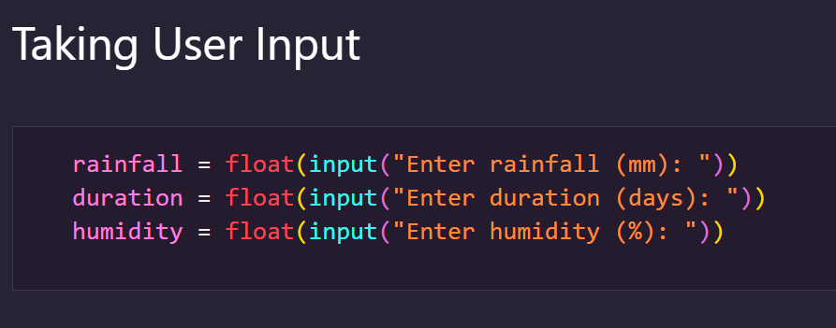
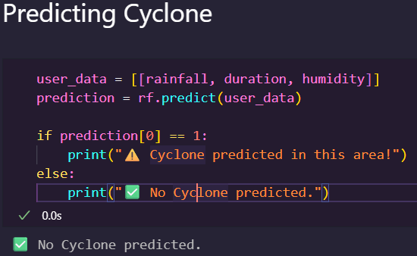
Screenshot of Output:

Slide 9
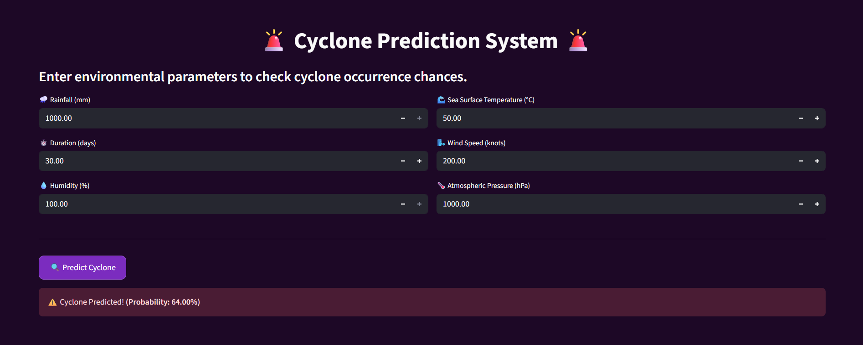
Screenshot of Output:

Slide 10
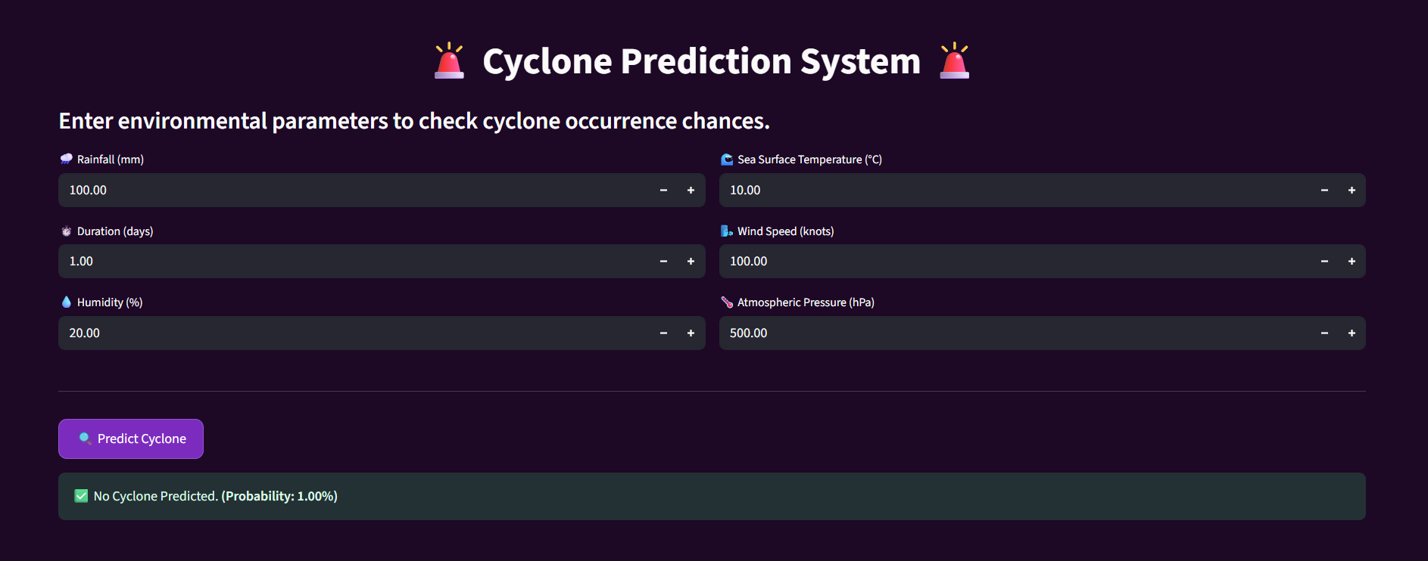
Screenshot of Output:

Slide 11
Conclusion:
This project successfully demonstrates the application of machine learning for cyclone prediction using meteorological factors such as rainfall, wind speed, humidity, and sea surface temperature.
Through data preprocessing, exploratory analysis, and model training with RandomForestClassifier, the system can provide insights into the likelihood of cyclone occurrence. While the model shows promising results, its accuracy depends on the quality and balance of the dataset.
Future improvements can include integrating real-time satellite data, advanced models (e.g., deep learning, ensemble methods), and expanding the dataset for more reliable and scalable predictions.

